Slide 1

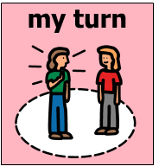
Whose turn is it to blow bubbles?
Image used with permission from:
https://openclipart.org/detail/127345/blowing-bubbles
Presentation created by Cristina Correa-Barron, MS, CCC-SLP in 2018
The Picture Communication Symbols ©1981–2018 by Mayer-Johnson LLC. All Rights Reserved Worldwide. Used with permission.

Slide 2
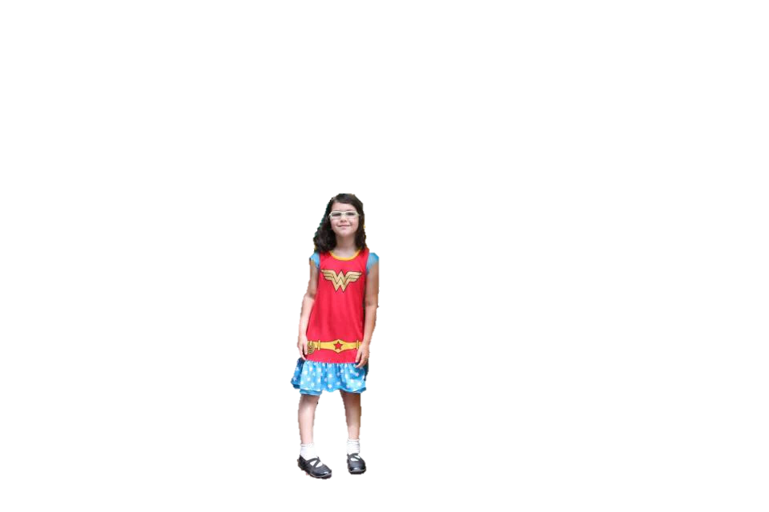
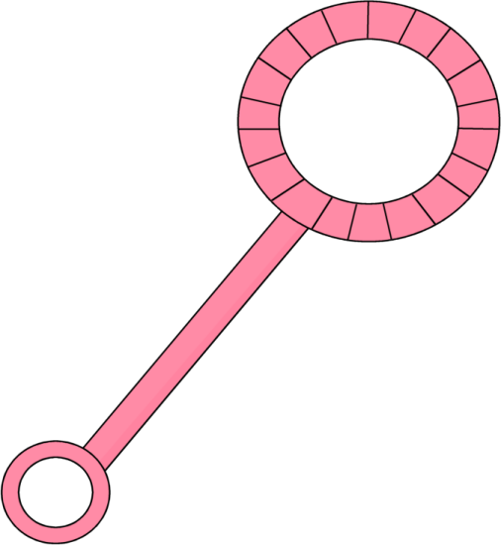
Whose turn is it to blow bubbles?
It’s my turn to blow bubbles!
Image used with permission:
https://www.mycutegraphics.com/graphics/bubble/pink-angled-bubble-wand.html
Presentation created by Cristina Correa-Barron, MS, CCC-SLP in 2018
The Picture Communication Symbols ©1981–2018 by Mayer-Johnson LLC. All Rights Reserved Worldwide. Used with permission.

Slide 3
The End

